Slide 1
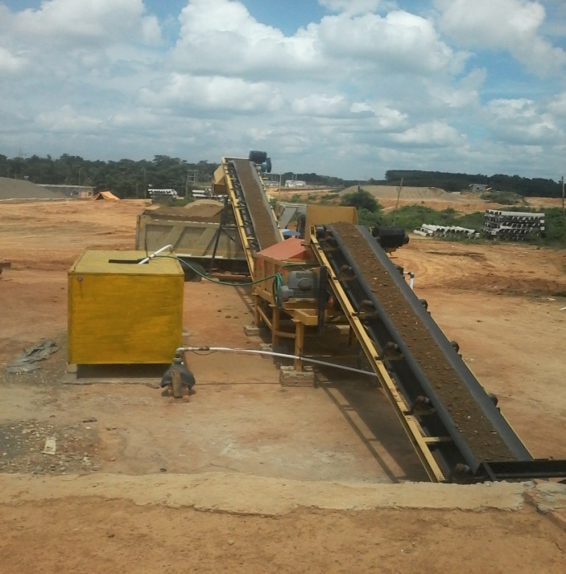
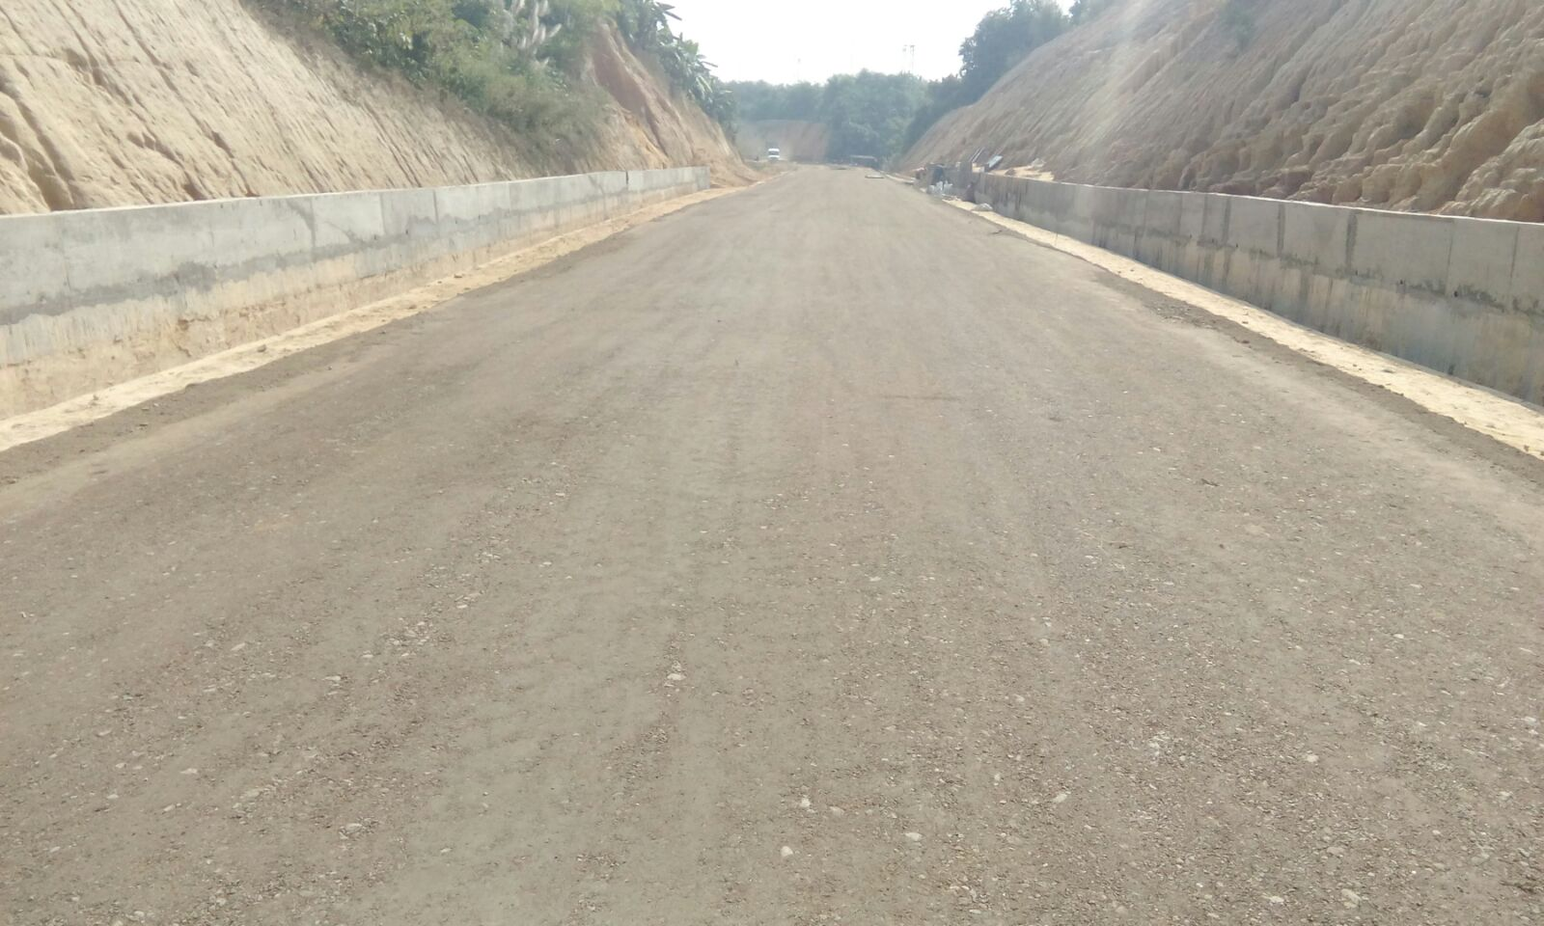
Mechanised Blending and Laying of Blanketing Material with application of Geo textile and Geo-grids in Agartala-Sabroom
______________________
International Seminar IPWE
Mumbai 12th &13th Jan 2017
Harpal Singh
CE/CON/8/MLG NFR
S.S Khongrymmai
Dy.CE/Con/2/AGTL
Supriya Dutta ,JE
Challenges in Design and Maintenance of track under Mixed Traffic Regime of Semi High Speed and Heavy Axle Load

Slide 2
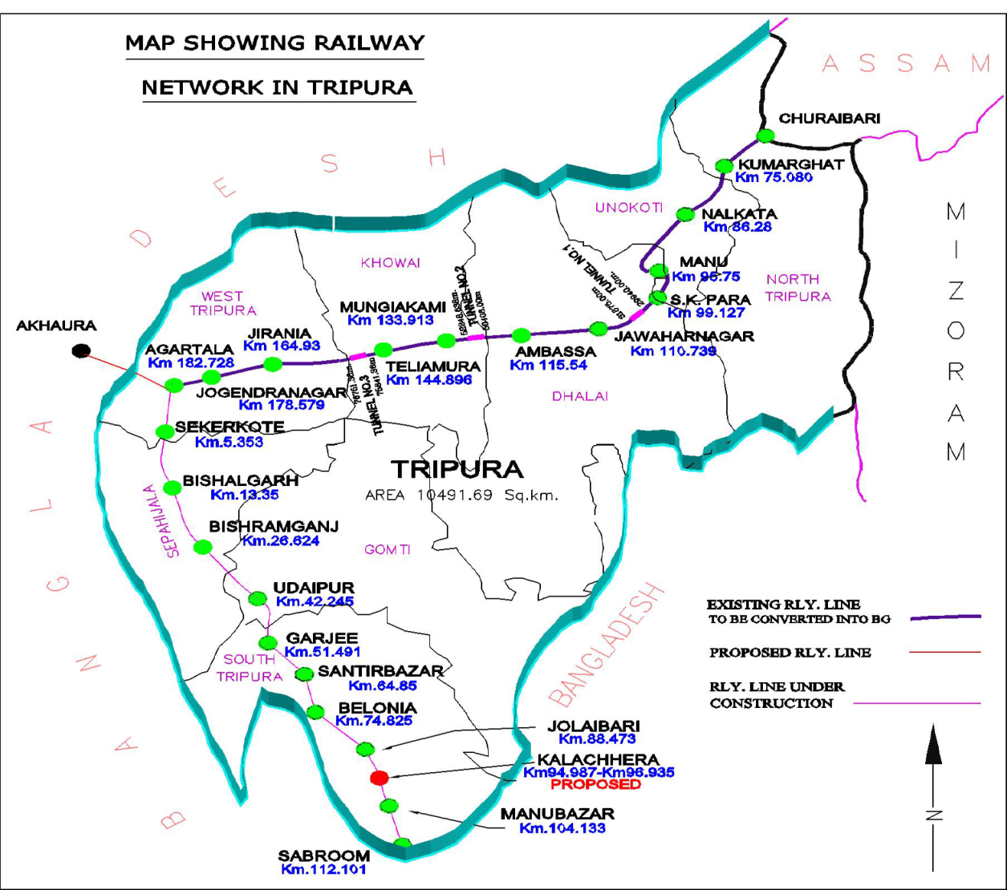
Railway Infrastructures in Tripura
Agartala-Sabroom Project
Sanctioned in 2008-09
Length =114Km
Commissioned=44Km
11 nos stations
Alignment through valleys and hills
Some swampy area and soil with high percentage of silt and clay

Slide 3
Sample of Geo-technical reports on constructed formation
Sl No | Chainage of Testing | % of fine | Category of Soil | Liquid Limit | Plastic Limit | Plasticity Index %
1 | 63.617 | 69.00 | SQ1 | 38 | 18 | 20.00
2 | 73.700 | 35.94 | SQ2 | 28.92 | 20.71 | 8.71
3 | 76.775 | 88.88 | SQ1 | 33.80 | 19.20 | 14.60
4 | 77.012 | 79.00 | SQ1 | 57 | 27 | 30.0
5 | 77.12 | 58.00 | SQ1 | 39 | 22 | 17
6 | 80.648 | 84.00 | SQ1 | 39 | 23 | 16
7 | 81.600 | 98.98 | SQ1 | 37.75 | 20.45 | 17.3
8 | 98.087 | 42.00 | SQ2 | 32 | 20 | 12.0
9 | 108.00 | 52.00 | SQ1 | 31 | 17 | 14.0

Slide 4
Consideration for Blanket thickness (25T)
Soil type | As per Existing GE:G-1 | GE:0014 (single layer). | GE:0014 ( two layer)
SQ1 | 130Cm | 100Cm | 100Cm
SQ2 | 90Cm | 75Cm | 45Cm
SQ3 | 75Cm | 60 Cm | 30Cm
With combination of Geo-Textile and Geo-Grids, a blanket thickness of 60cm has been adopted in Agartala-Sabroom Project against SQ1 Soil
SQ1 (fines >50%), SQ2 (fines: 12 to 50%), SQ3 (fines <12%)

Slide 5
Blanket and its Functions
Blanket is a quality soil between the ballast and the sub-grade with main functions
It reduces stress to sub-grade to a tolerable limits
It increases track modulus through out and thereby reduces track deformation.
It prevents ballast penetration in sub-grade and hence mud-pumping
It prevents upward sub-grade fines migration
It facilitates drainage of surface water from above
It ensures dissipation of pore water pressure in sub-grade.

Slide 6
Blanket on embankment filling

Slide 7
Specification and thickness of Sub grade layer for Heavier Axle Load (Single Blanketing layer over embankment Fill) for 25Axle Load
Layer | Sl No | Criteria | Limits
Blanket-Well graded sand gravel layer | 1 | Cu | >7
 | 2 | Cc | between 1 to 3
 | 3 | Loss Angeles Abrasion Value | < 35%
 | 4 | Soaked CBR Value at 100%of MDD | ≥ 25 | (SQ1/SQ2/ SQ3 are soil below blanket). SQ2/SQ3 are preferred
 | 5 | Minimum Ev₂ (Determined | ≥ 100 | Blanket compacted up to 98% MDD
Embankment Fill (Top layer) | 1 | CBR=5-7(compacted at 98% MDD), CBR=3-4 for SQ1. SQ1 to be avoided | T=50cm | (Not follow here)
 | 2 |  | SQ2/SQ3 soil

Slide 8
.
Particles Size gradation Curve Should be more or less within Enveloping Curves of blanket Material as shown below
Sl No | 1 | 2 | 3 | 4 | 5 | 6 | 7 | 8 | 9
IS Sieve (mm) | 40 | 20 | 10 | 4.75 | 2 | 600mi | 425mi | 212mi | 75mi
% passing | 100 | 80-90 | 63-85 | 42-68 | 27-52 | 13-35 | 10-32 | 6-22 | 3-10

Slide 9
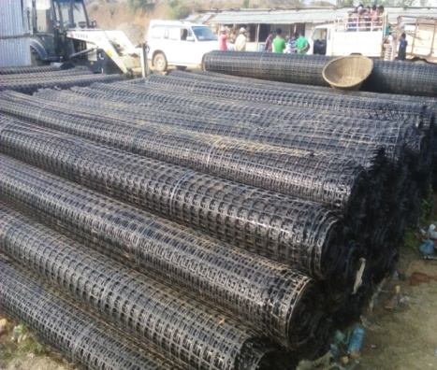
Geo-Textile and its Functions
acts as separators between sub-grade and blanket layer
acts as lateral drainage of water entering from above or below leading to side drain.
acts like reinforcement for blanketing layer
filtrates pore water rising from sub-grade
Geo-Textile
Geo-grids

Slide 10
Geo-Grid and its Functions
Geo-grids stabilize the formation by improving lateral confinement and bearing capacity, increasing resilient modulus and decreasing differential settlement.
Stabilizing effect is achieved through two mechanisms
a) Lateral restrain of the ballast and formation through interlocking (between aggregate and geo-grids) and friction (between soil and the geo-grid)
b) Sub grade restraint/increase in the system bearing capacity
Specifications as per IR Unified Standard Specifications

Slide 11
Pug mill type blenders
Four Bins of 4 Cum Capacity
Production 600 Cum per day @60Cum per Hour

Slide 12
Trial Mix of Blanket
Identify of the useable materials/soils.
Take equal weight of the materials for sieve analysis.
Write down the weight retained at each stage for all the soils.
Apportion of percentage component to each material and work out the theoretical mix.
Draw particles size distribution curve of mix to find out desirability of gradation of blanket materials, as per guideline vide RDSO/2007/GE: 0014 Vide page -28. Of heavy axle load 25T.
If not successful, then make another trail, and so on.

Slide 13
Based on the above four materials a trail for the blanket is done on the following proportion
CALCULATION OF MIX.
sieve size (in MM) | wt retained (in gm) | % of wt retained | % of Wt retained as per grain size | Nature of Granular materials | Mark of Bin at batching plant | Remarks
40 | 0 | 0 | 26 | 20 mm down | BIN-1
20 | 510 | 10.2
10 | 790 | 15.8
4.75 | 1000 | 20 | 37.5 | 10mm down | BIN-2
2 | 875 | 17.5
0.6 | 725 | 14.5 | 24.5 | fine sand | BIN-3
0.425 | 175 | 3.5
0.212 | 325 | 6.5
0.075 | 350 | 7 | 12 | Fine grain soil mix with stone dust sand | BIN-4
pan | 250 | 5

Slide 14
DESIGN OF BLANKETING MATERIALS FOR BATCHING PLANT Sieve analysis
sieve size (in MM) | wt retained (in gm) | Cumulative wt. retained ( in gm) | % of cumulative wt retained | % of passing | Ref. Range of passing
40 | 0 | 0 | 0 | 100 | 100%
20 | 510 | 510 | 10.2 | 89.8 | 80-100%
10 | 790 | 1300 | 26 | 74 | 63-85%
4.75 | 1000 | 2300 | 46 | 54 | 42-68%
2 | 875 | 3175 | 63.5 | 36.5 | 27-52%
0.6 | 725 | 3900 | 78 | 22 | 13-35%
0.425 | 175 | 4075 | 81.5 | 18.5 | 10-32%
0.212 | 325 | 4400 | 88 | 12 | 6-22%
0.075 | 350 | 4750 | 95 | 5 | 3-10%
pan | 250 | 5000 | 100

Slide 15
Envelop curve of Design mix.
D10 | D30 | D60 | CC | CU | Ref. range
 |  |  |  |  | CC | CU
0.17 | 1.3 | 6 | 1.66 | 35.29 | 1 to 3 | > 4, preferable more than 7

Slide 16
Preparation of Sub grade
Top slope 1 in 30 ways from centre.
Extra wide bank by 500mm on either side & then cut
& dressed to avoid loose earth on shoulders.
Minimum overlap of 200mm between each run of
roller
At the end of working day, fill materials should not be
left un-compacted
After finishing formation movement of vehicles
should not be allowed on top.
Usually side slope 2:1 up to 6.0m height
Top width 6.85m in filling & 6.25 in cutting.

Slide 17
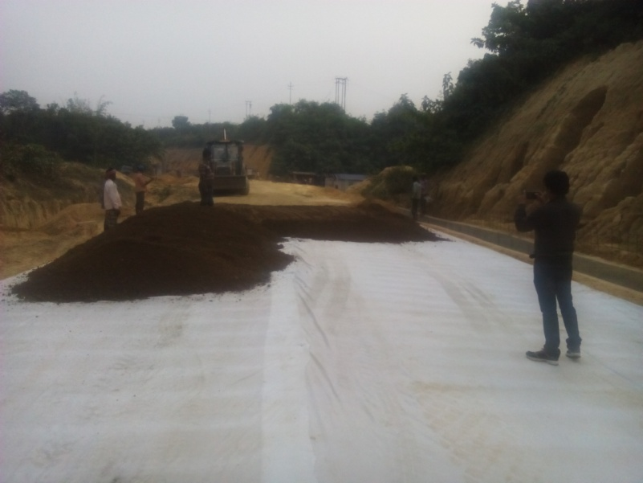
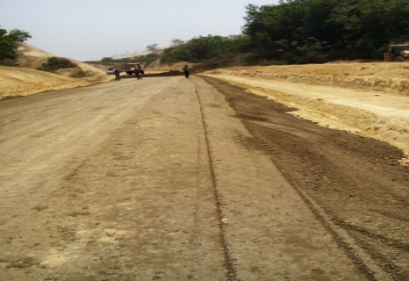
Laying of Geo-Textiles (in between sub grade and blanket layer)
Geo textile are being laid over well compacted prepared sub grade .
Minimum lapping (lateral & longitudinal direction) is 300mm.
Cross slope is 1 in 30 and longitudinal gradient as per designated gradient.
Use and selection of geo–synthetics should be done in consultation with RDSO.
Laying Geo -Textile
Spreading ofBlanket

Slide 18
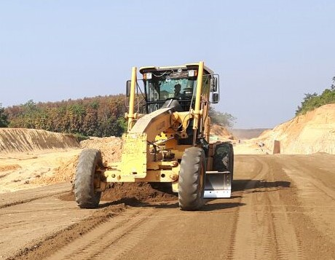
Procedure of laying Blanket
Blanket materials are spreaded with a tractor mounted grader
In layer of 30 cm thick
Compacted with 11-12 tonne vibratory roller
8-10 number of passes given to achieve desirable compaction.
OMC of produce blanket 8-9%
Spreading with Grader
11t Vibratory roller

Slide 19
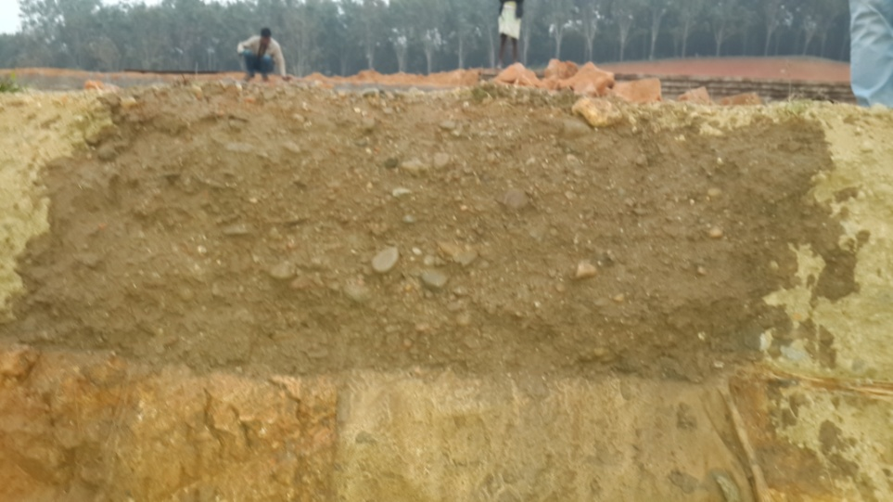
Laying of Bi-Axial Geo -Grids in the middle of blanket layer
BI-Axial Geo-grids are being laid at middle of blanket layer and over the well prepared well compacted blanket layer.
This give better result as per report by the IIT, Kharagpur.
1st Layer X-Section of Blanket

Slide 20
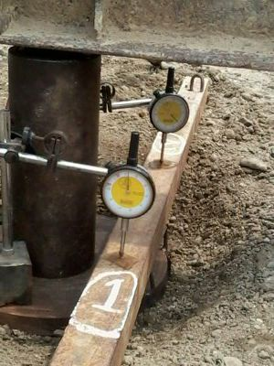
Quality Assurance Tests on Compacted Layer: Two tests are conducted on the compacted layer
Second Step Plate Load Test (optional) –Ev2
Compaction Test
For Deformation Modulus Ev2 at @1Km

Slide 21
Test report of EV2 (Mpa) on virgin soil & on blanket materials at sites
Chainage | Sub-grade | 30 Cm blanket | 60cm blanket | Remark
64.23 | 52.5 | 131.7 | 174.419 | Cutting
74.675 | 20.69 |  |  | Filling
75.220 | Not done | 103.23 MPa |  | Filling
76.250 |  | 78.32MPa |  | Filling
75.60 | 60.70 | 129.3 | 168.1 | Cutting

Slide 22
Test report of Compaction and CBR on blanket materials in field
By core cutter |  | LAB TESTS
Chainage (Km) | Result (%) | CBR Value @100% MDD
75/450 | 99.75 | 30.60
75/525 | 101.25 | 34.20
64/850 | 99.85 | 32.79
65/220 | 103.35 | 32.75
LAB TEST Report:-
LAAV= 25-30% ˂ 35%
MDD =2.12 gm/cc
CBR Result=30-33% > 25%

Slide 23
LABORATORY SCALE MODEL TEST EVALUTION OF EV2 AT IIT,KHARAGPUR
EV2 (Modulus of Elasticity at the second step loading) has been evaluated, through a test bed-cum-loading frame assembly in the laboratory, test also been conducted with and without geosynthetics reinforcement (i.e. geogrid and geotextile).
The evaluation of the strain modulus of railway track formation at Agartala, the second step loading(EV2) through laboratory scale model plate load tests, as per DIN 18134 (2001), using geo-grid and geo-textile reinforcement done by the IIT, Kharagpur.

Slide 24
SUMMARY OF MEASURED EV2 VALUES
Test series | Test no | Test bed details | Reinforced details | EV2 (MPa)
1 | 1 | Embankment + subgrade | unreinforced | 107.7
 | 2 |  |  | 100.7
 | 3 |  |  | 108.1
2 | 4 | Embankment+subgrade+blanket | unreinforced | 123.2
 | 5 |  |  | 122.1
3 | 6 | Embankment +subgrade+blanket | Geo-grids at bottom of blanket | 138.6
 | 7 |  |  | 134.4
4 | 8 | Embankment +subgrade+blanket | Geo-grids at middle of blanket | 145.3
 | 9 |  |  | 143.9
5 | 10 | Embankment +subgrade+blanket | Geo-textile at bottom of blanket | 129.0
 | 11 |  |  | 120.0
6 | 12 | Embankment +subgrade+blanket | Geo-textile at middle of blanket | 128.6
 | 13 |  |  | 134.0

Slide 25
Economy Of using Blanket with Geo-synthetics
This can be seen below
Blanket | Qty per metre tract(cum) | Cost(Rs) per Cum/sqm | Cost per metre of track | Total cost | Saving
1m Blanket | 8.85 | 3650 | 32302 | 32302 | 36% saving
60 cm blanket with Geo-textile and Geo-grids | 4.83 | 3650 | 17629 | 20619.00
 | (8.65+7.5)sq | (120.38+259.87) | 2990.00

Slide 26
Conclusion
IIT test result on blank layer with geo-grids in the middle give a maximum deformation modulus of 145MPa
Blanketing is a must for strong, durable and lasting track
In Agartala-Udaipur geo-grid where laid between blanket and ballast as given in RDSO Guideline
Now in Udaipur-Sabroom Geo-grids is being laid in the middle i.e of blanket i.e 30cm with Geo-textile in bottom after consultation with RDSO.
Use Geo-grids and Geo-Textile reduce blanket thickness and Cost.

Slide 27
Finished blanket layer
THANK YOU
.

